Slide 1

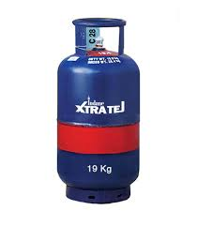

Knowledge Sharing Session
On Indane Nanocut

Slide 2
Main Speaking points :
What is Nano Cut ? What is Xtra Tej ?
What is DA ? And why is it Important?
Comparison between Nanocut and DA
How to switch from DA to Nanocut ?
Success Stories
Alternate customers.
Incentive slabs for distributors
How to approach customers
Performance in present FY and way forward
Materials to be shared with customers
Questions

Slide 3
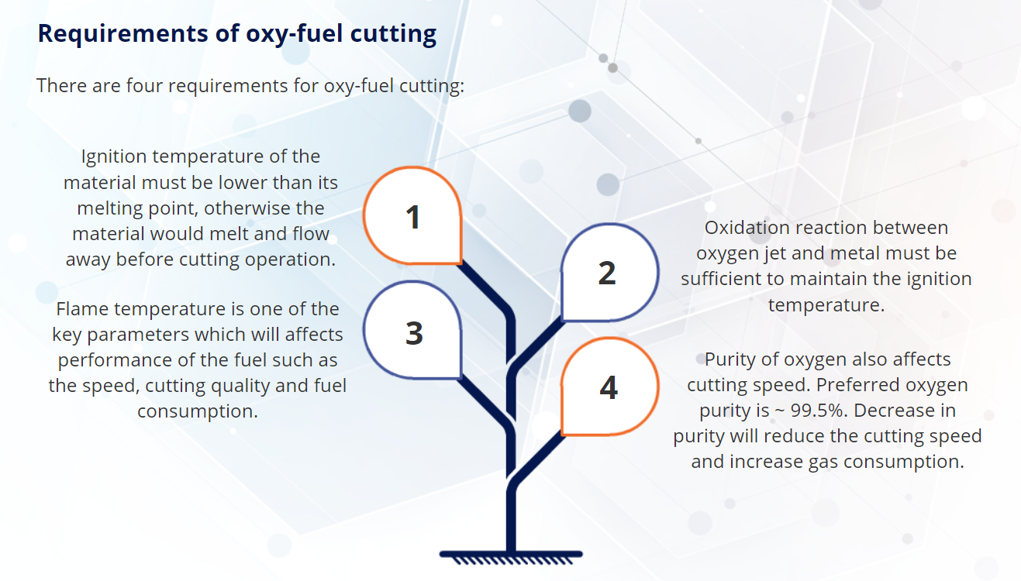

Slide 4
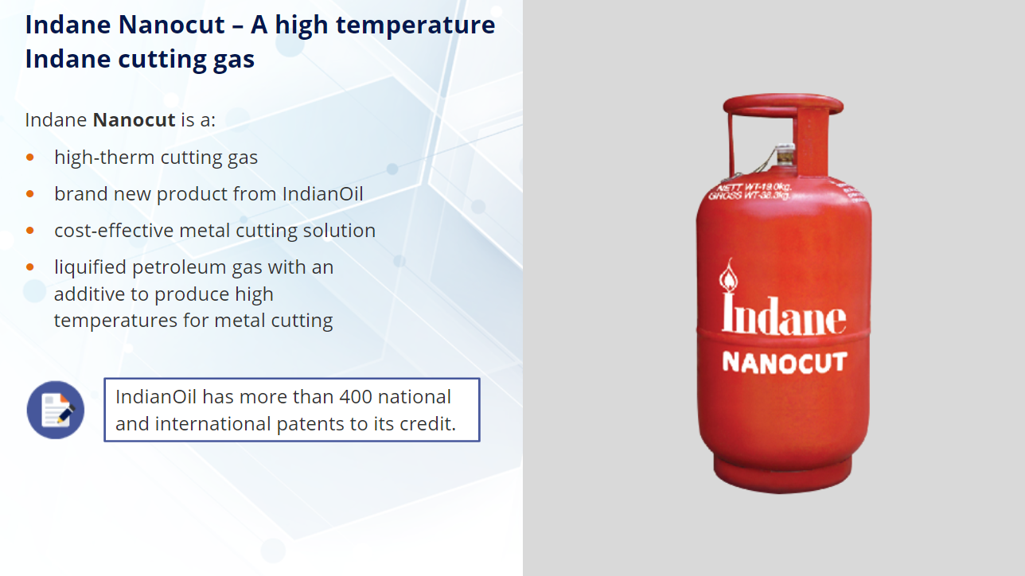

Slide 5
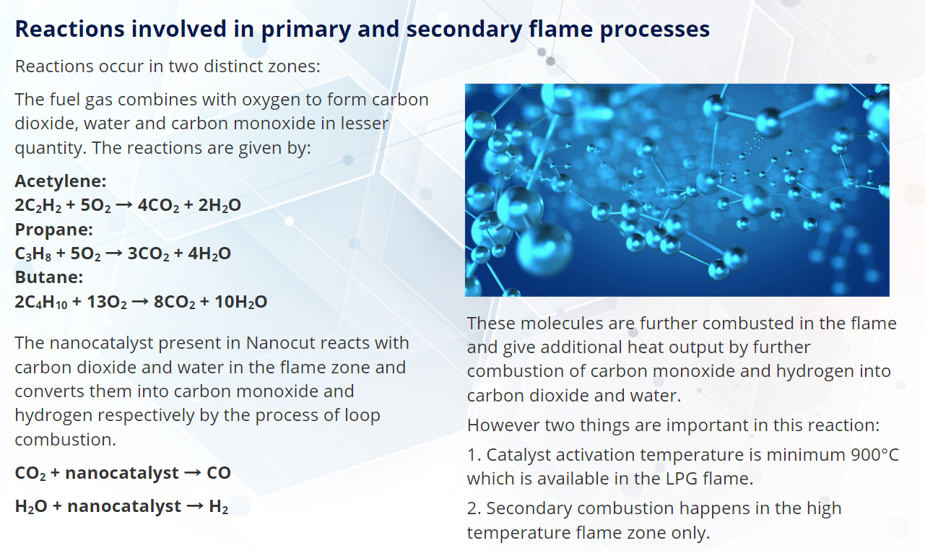

Slide 6
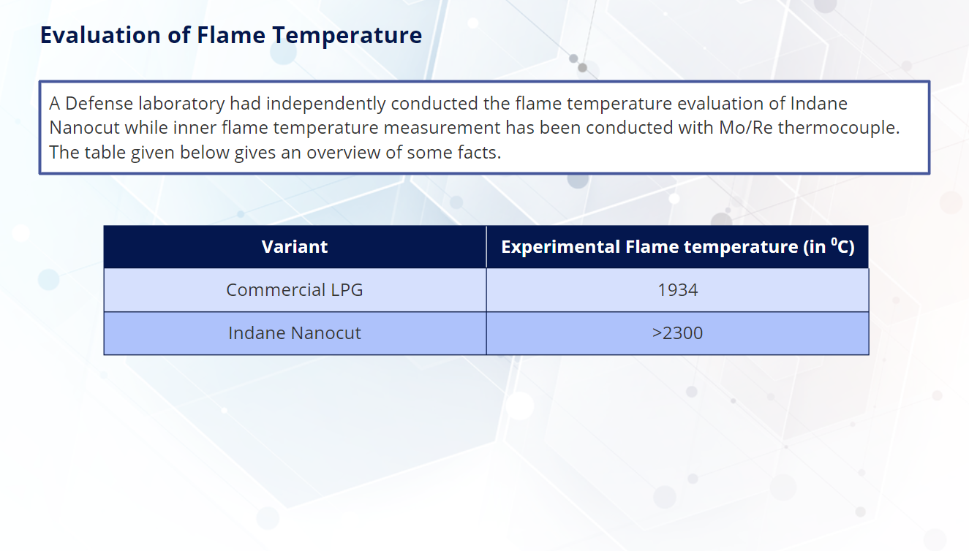

Slide 7
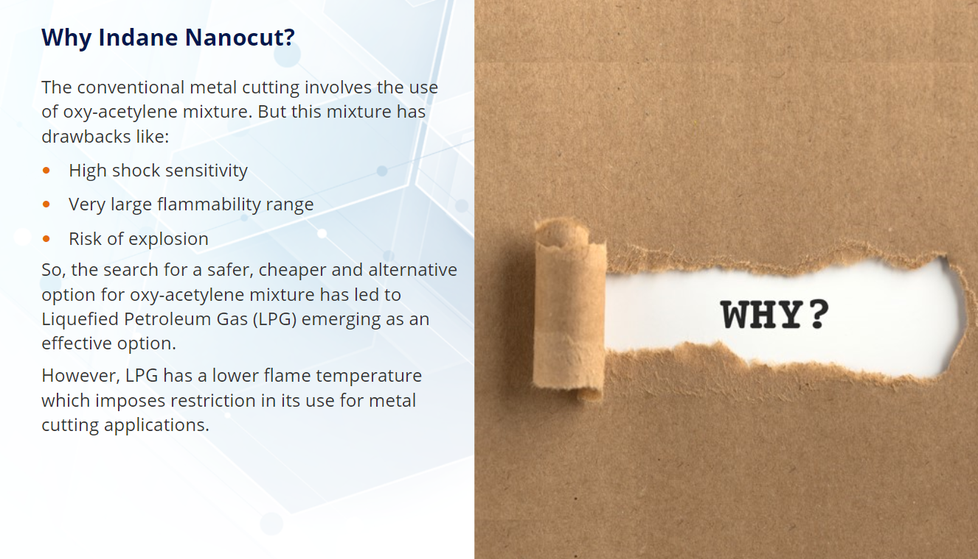

Slide 8
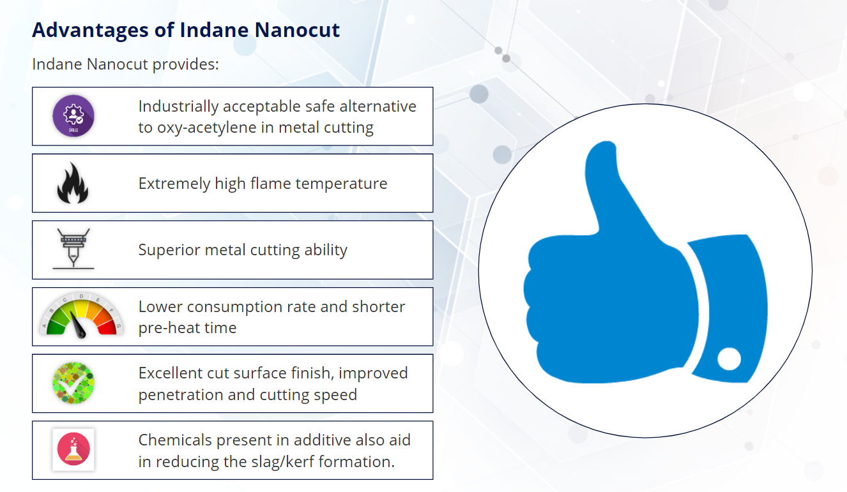

Slide 9
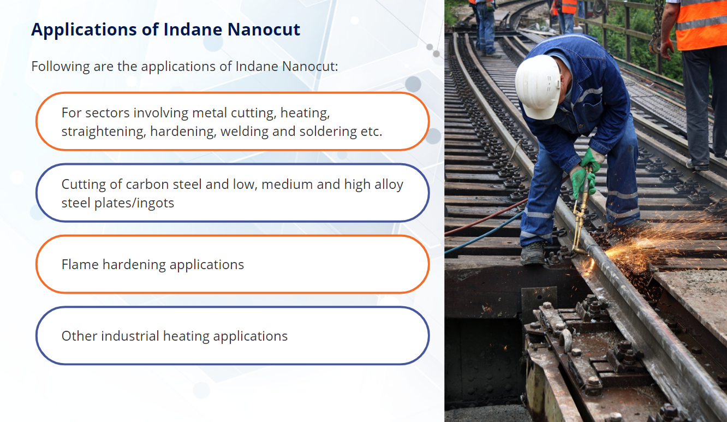

Slide 10
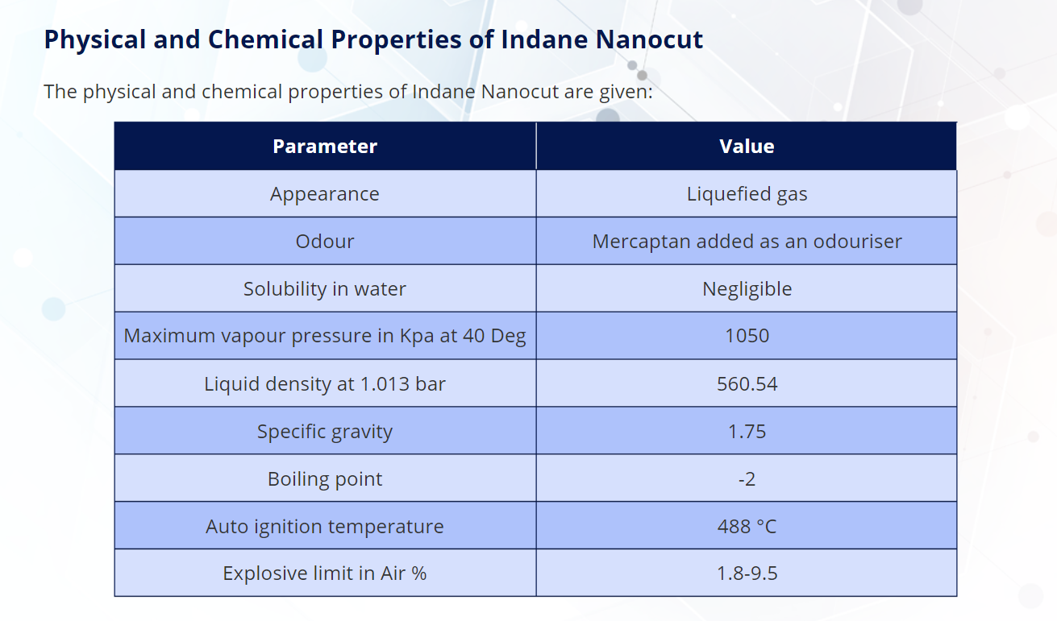

Slide 11
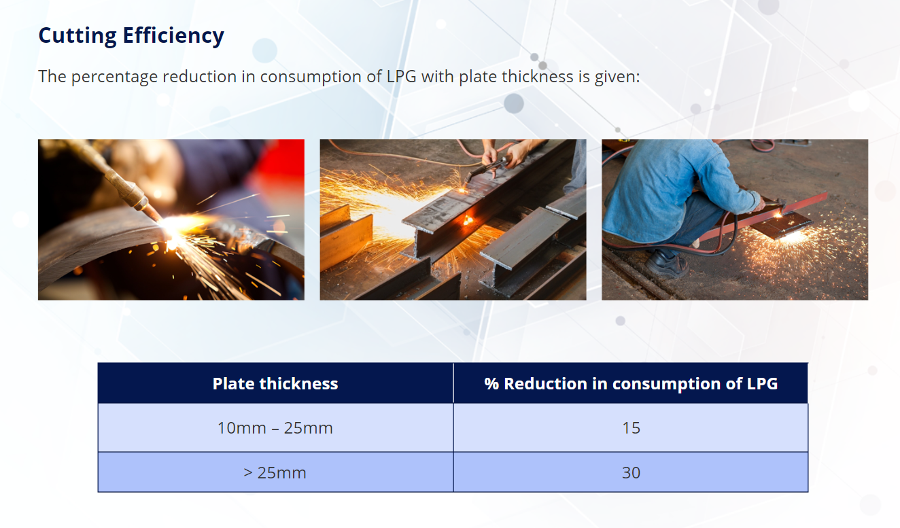

Slide 12
NANOCUT LPG AND ACETYLENE - COMPARISION
S.N. | PARAMETER | NANOCUT LPG | ACETYLENE (DA)
1 | Purpose | Cutting (upto 400mm), Heating, Straightening, Hardening etc | Cutting (upto 400mm), Heating, Straightening, Hardening etc
2 | Cost / Kg (Rs) | 145.97 | 260-330
3 | Savings % | 50-60% More than DA | 50-60% More Expenditure Than Indane Nanocut LPG
4 | Security Deposit | 1/12th of Acetylene Per KG (Rs. 1700/- per 19Kg) | Rs. 7000/- per 7Kg
5 | Weight (in Kg) | 19 Kg | 5 – 7.0 Kg
6 | Space for Storage | 1/5th of Acetylene , two cylinders can be stacked vertically. (Total weight 38Kg) | Only one cylinder (Total weight 7 Kg)
7 | Vapor Pressure (Kpa) | 1048 | 6000
8 | Safety at use | Nil / Rare | High Chances of backfire, Self explosive
9 | Surface for cutting | Smooth cutting, No blistering and carbon deposition, minimum metal loss | Rough and presence of carbon deposition, 15-20% more metal loss
10 | Time for Refill | 45 Second / 19Kg Nanocut | Minimum 7 hours (Chance of explosion if refilling time reduced)

Slide 13
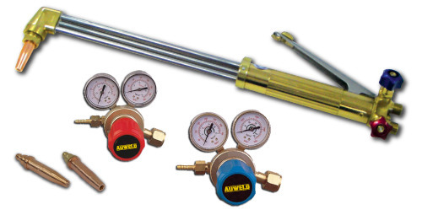
NANOCUT LPG AND ACETYLENE - COMPARISION
S.N. | PARAMETER | NANOCUT LPG | ACETYLENE (DA)
11 | Duration to empty | No time limit | Minimum 7 hours, chances of explosion in fast using.
12 | Weight of empty Cylinder (in Kg) | 19-21 | 55-57
13 | Flammable components | 1.8-9.5% | 2.5-82%
14 | Total Calorie (MJ / CUM) | 117 | 59
15 | Flame Temperature in 0C | 3100 | 3100-3200
16 | Nanocut LPG and Acetylene Consumption in Each Work | Approx same for both products
17 | Oxygen Consumption for Nanocut LPG and Acetylene | Approx same for both products
18 | Chemical composition | Propane+Butane+Additive |  | Ethyne
Changes in equipment for the use of Nanocut |  | Only cutting nozzle and cylinder valve-adapter will have to be replaced which is used in Acetylene, at a nominal cost. No other new equipment required.

Slide 14
Existing product (acetylene / DA) can be replaced with Nanocut LPG.
Nanocut LPG is about 60% cheaper and safer to use than LPG/ DA in cutting, heating hardening, straightening and other heating purposes.
Nanocut LPG is 30% cheaper than normal LPG, which is used to cut plates of thickness of 1 inch (25 mm) and beyond.
In the presence of oxygen, the flame temperature of Nanocut LPG (300 ⁰C higher than normal LPG) is 3100 ⁰C while the flame temperature of normal LPG is 2800 ⁰C.
Size of Cutting Nozzle-
Thickness |  | Size of cutting nozzle | Pressure of Oxygen
MM | Inch |  | Kg/Cm² | Lb / Inch²
6 | 1/4 | A-1/32 | 1.4 | 20
12 | 1/5 | A-3/64 | 2 | 30
25 | 1 | A-1/16 | 25 | 35
50 | 2 | A-1/16 | 3.2 | 45
75 | 3 | A-1/16 | 3.5 | 50
100 | 4 | A-1/16 | 4.2 | 60
150 | 6 | A-5/64 | 4.5 | 65
200 | 8 | A-3/32 | 4.9 | 70
250 | 10 | A-7/64 | 5.3 | 75
300 & Above | 12 | A-1/8 | 5.3 | 75

Slide 15
Comparison of Nanocut LPG and Acetylene:
Sl | Characteristic | Nanocut | Acetylene / DA | Remarks
1 | Explosive Limit | 2% to 10% | 2.5% to 81% | LPG -Difficult to ignite unless the mixture is just right.
2 | Cylinder Working Pressure Kg/cm² | 5-Mar | 18-20 | Acetylene –In case cylinder explodes during or following a fire, the resulting dangers can include a travelling fire ball, projectile hazards, flying glass and structural damage to nearby buildings.
3 | Detectability in case of Leakage | Easy to detect | Difficult to detect | LPG -In case of a leakage, can be detected easily because of unique pungent smell. Ethyl Mercaptan is added to detect leakage at 20% of LEL.
4 | Density Vapour | 1.97 | 1.11 | 1. LPG - Heavier & has tendency to settles down at lower spots. Narrow Explosive range.
 |  |  |  | 2. ACETYLNE – Lighter and tends to float. Huge Explosive range along with lesser density makes more lethal combination in case of leakage.
 |  |  |  | 3. Gases with Lesser density along with narrow Explosive Limit would be more Safer to use.

Slide 16
Comparison of Nanocut LPG and Acetylene:
Sl | Characteristic | Nanocut | Acetylene / DA | Remarks
5 | Measurability | Supplied in KGs | Supplied in Cubic meters | 1. Weight can be easily measured for LPG cylinders. Chances of pilferage and short delivery reduced.
6 | FLASHBACK | NO | YES | LPG
 | This commonly results from the formation of a flammable mixture in the hoses at the time the blowpipe / torch is lit. The flame can travel back along the hoses and reach the cylinder |  |  | 1. There is no Oxygen in LPG to support Combustion.
 |  |  |  | 2. Installation Code and Regulations doesn’t demand.
 |  |  |  | ACETYLENE
 |  |  |  | 1. If the flame reaches the cylinder it can trigger decomposition of the acetylene.
 |  |  |  | 2. Flame arrestor and check Valves installed at Torch base as well as regulator Hose Connections.
7 | Design Temperature of Cylinders | Nanocut cylinders are designed for working temperature of 65 deg Centigrade | Acetylene cylinders are designed for working temperature of 52 deg Centigrade | As per safety data sheet of Acetylene:
 |  |  |  | Store only where temperature will not exceed 125°F (52°C).
 |  |  |  | Use and store only outdoors or in a well-ventilated place
 |  |  |  | Acetylene is recommended for use in outdoor only and also within atmospheric temperature of 52 deg Max.
 |  |  |  | Nanocut LPG can be used till 65 deg centigrade.

Slide 17
Comparison of Nanocut LPG and Acetylene:
Sl | Characteristic | Nanocut | Acetylene / DA | Remarks
8 | Decomposition : What is within cylinders | LPG (19 KG) and 60 ml Nanocut additive | Filler material, acetone and Acetylene. | Achieving the correct acetylene to acetone ratio is important to avoid acetylene decomposition propagating within the cylinder. It is also important to achieve the correct quantities of acetylene and acetone in order to avoid hydraulically filling the cylinder, with the attendant potential for the cylinder to burst with an increase in temperature.
 |  |  |  | Another important aspect is the management of the porous mass within the DA cylinder
 |  |  |  | In case of Nanocut LPG it is 100% safe as there are for filler materials.
9 | Withdrawal of gas | Nanocut LPG has no high withdrawal hazard. | High withdraw Acetylene will result in come out of acetone. It cannot be decanted before 7 hours. | No risk in case of LPG due to higher withdrawal rate.
10 | Hazard due to tilting of cylinders in horizontal position. | Normally recommended to keep in vertical position. | Always recommended to keep in vertical position. | Acetylene cylinders contain a porous mass and liquid acetone that dissolves the gas. If a cylinder has been transported, it must be left to settle in an upright position on arrival. This gives the liquid acetone time to return to its correct place in the porous mass. Failure to do so can cause quality problems with acetone liquid getting into the gas. In extreme situations, this might make the cylinder less safe to use.
11 | Impact of decomposed or Valve leak cylinders on property and personnel handling | Minimum | Extremely High | It will hit nearby property and person present nearby due to high pressure and 3 times more mass. Momentum will be 20 time more than a LPG Nanocut cylinders.
 |  |  |  | In short working with DA is like working with a bomb.
 |  |  |  | In case of valve leak/opened it can be more devastating than oxygen cylinders.

Slide 18
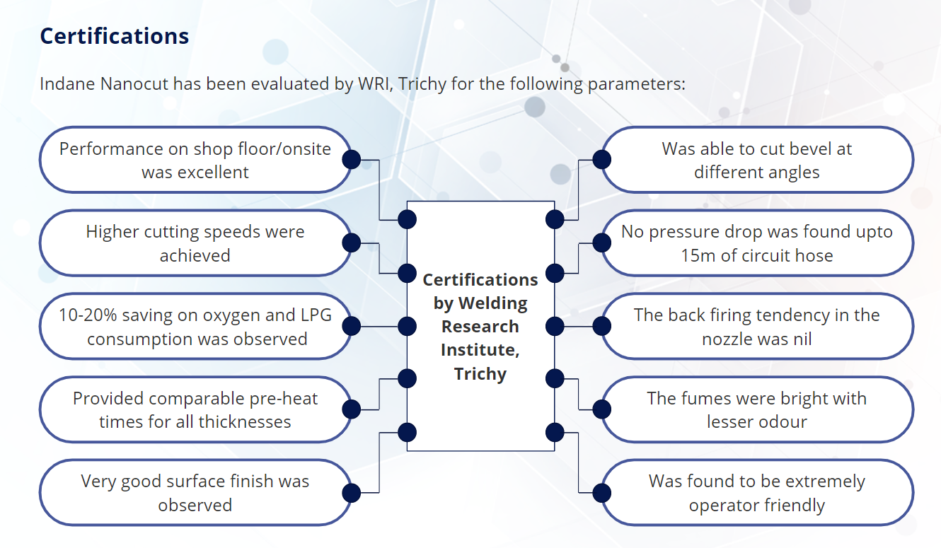

Slide 19
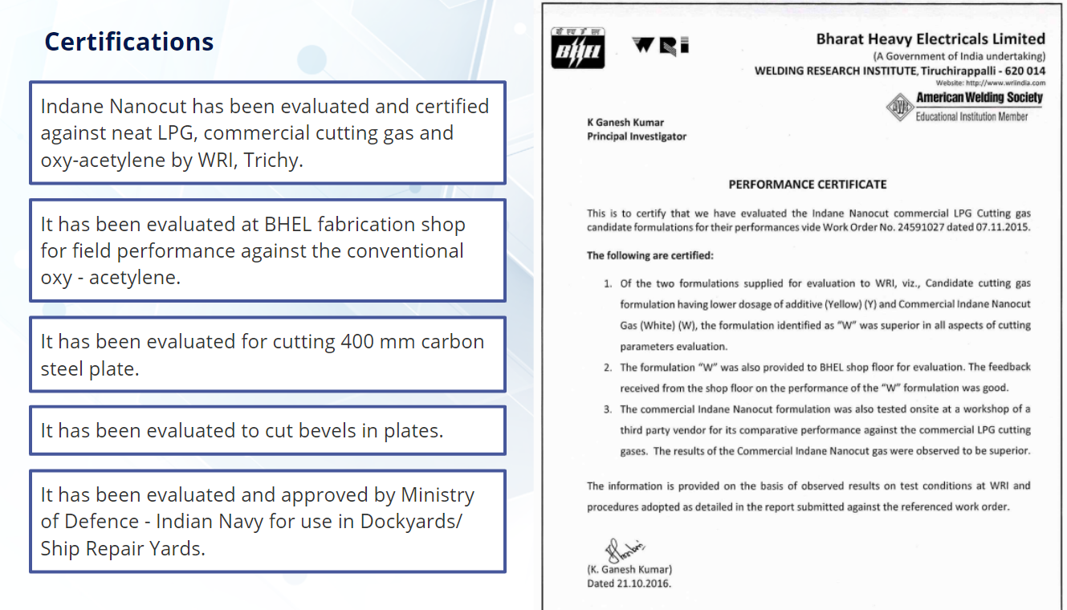

Slide 20
Thank You

